Slide 1
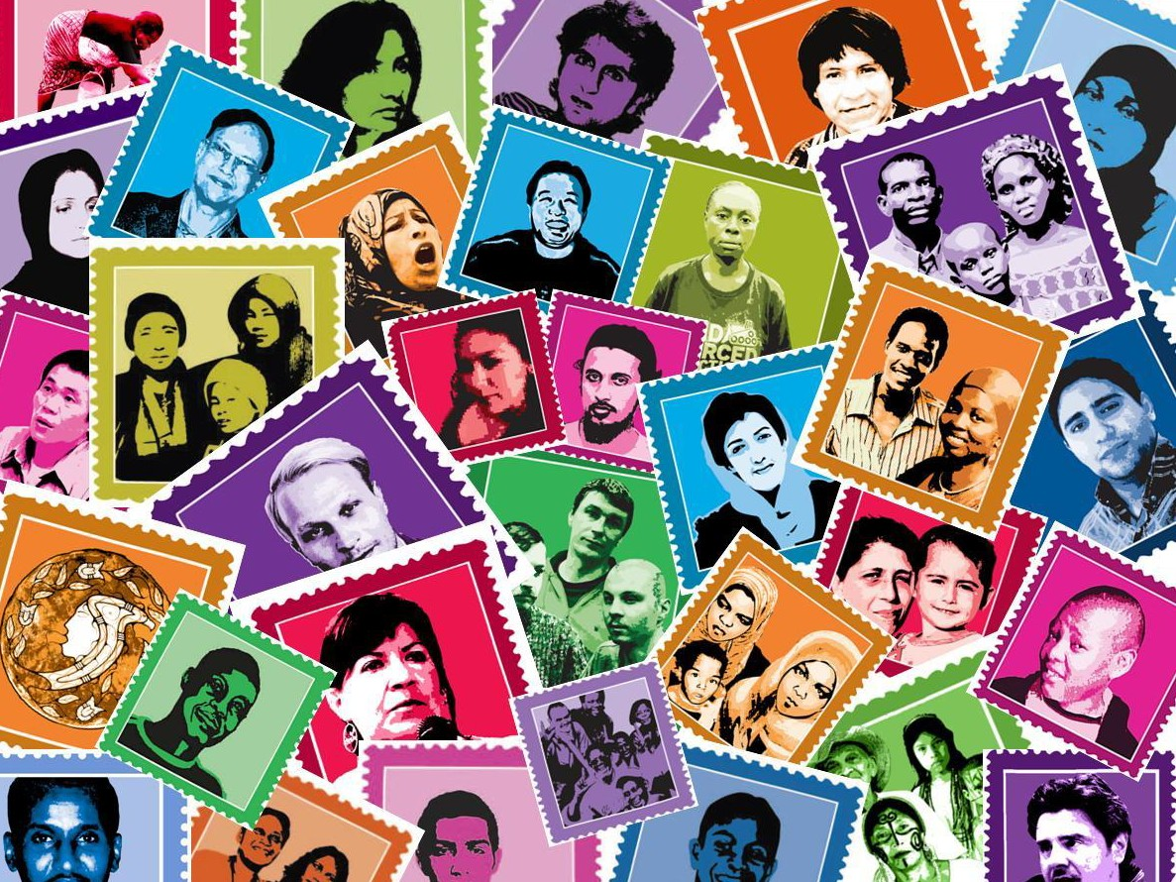

THE WORLD’S LARGEST
LETTER WRITING EVENT

Slide 2

10
cases
IN 2016!
^{over} 200 countries
4.6 million
ACTIONS

Slide 3
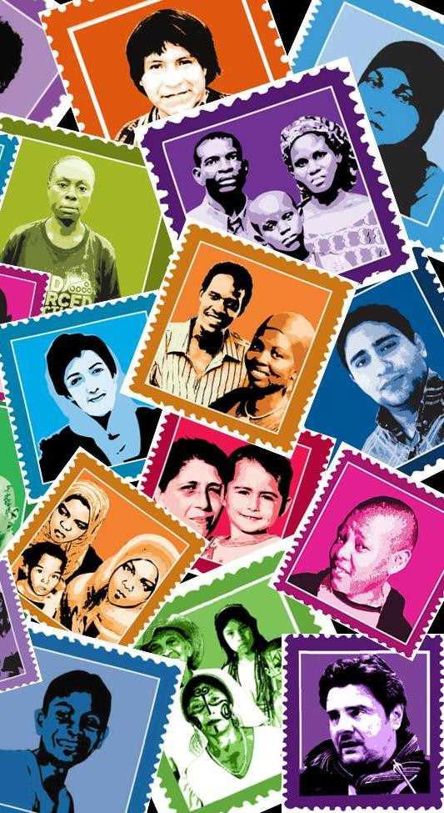
WRITE 4 RIGHTS
SUCCESS STORIES

Slide 4


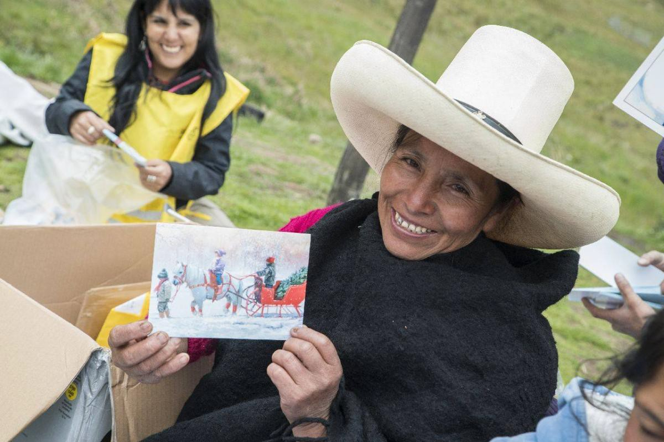
2016 WRITE FOR RIGHTS CASE:
Máxima Acuña
In May 2017, all criminal charges were dropped against Máxima Acuña, a peasant farmer who is defying one of the world’s biggest gold mining companies. Over 300,000 actions were taken on behalf of Máxima Acuña, many of which urged the Peruvian authorities to protect her and her family from violence, harassment and intimidation, and to publicly recognize Máxima’s legitimate and important work as a human rights defender working on issues of land and the environment.
Write for Rights has given Máxima “the feeling that I am protected, that my children are protected.” The letters have made a difference to her to know that “there are people who are helping us to seek justice.”

Slide 5

2015 WRITE FOR RIGHTS CASE:
ALBERT WOODFOX
“Your messages from beyond the prison walls have become an enormous source of strength for me. I would like to thank all of the members of Amnesty International and its supporters for all of the wonderful work they are doing on [my] behalf.”
The USA’s longest serving prisoner held in isolation

Slide 6
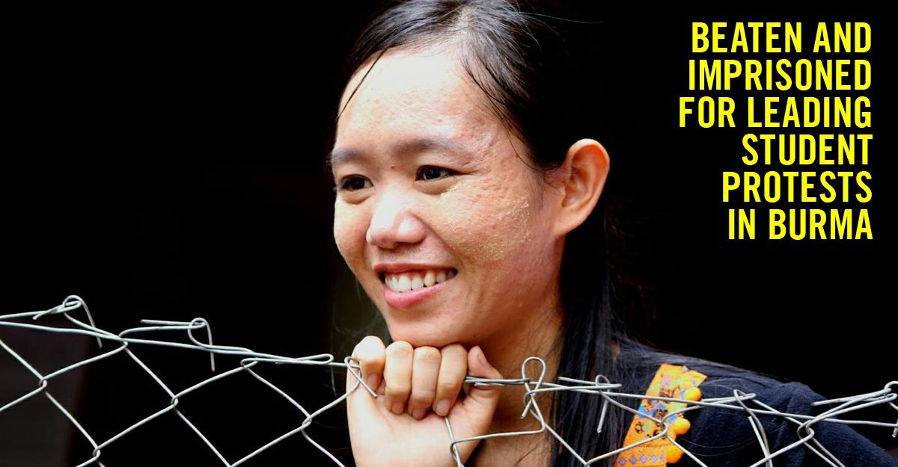
“I am so grateful to Amnesty and all of the people who participated in the campaign for my release. International movements like yours put pressure on governments for our physical freedom, but knowing we have your solidarity also supports us mentally.”
2015 WRITE FOR RIGHTS CASE:
PHYOE PHYOE AUNG

Slide 7
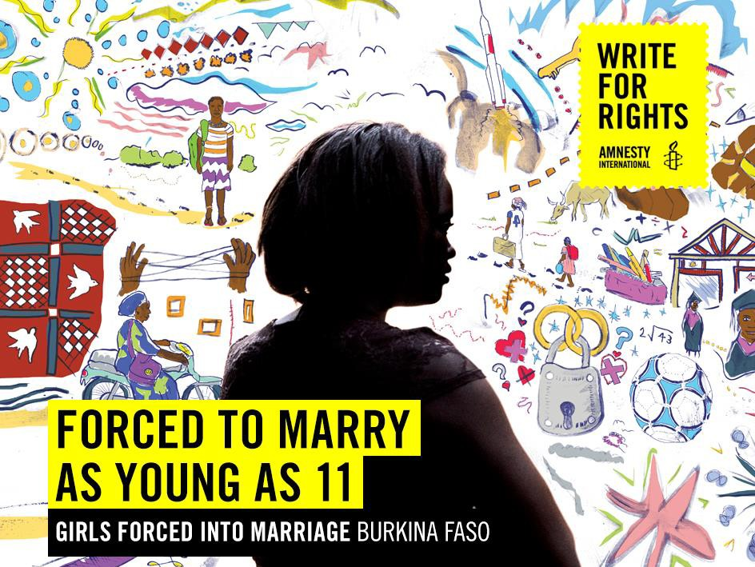


2015 WRITE FOR RIGHTS CASE:
WOMEN AND GIRLS IN BURKINA FASO
More than half a million took action– and it worked! The Ministry of Justice in Burkina Faso affirmed
the government’s commitment to eradicating early and forced marriage, and said they had felt compelled to do so after “receiving letters, emails and correspondence from people all over the world”.

Slide 8
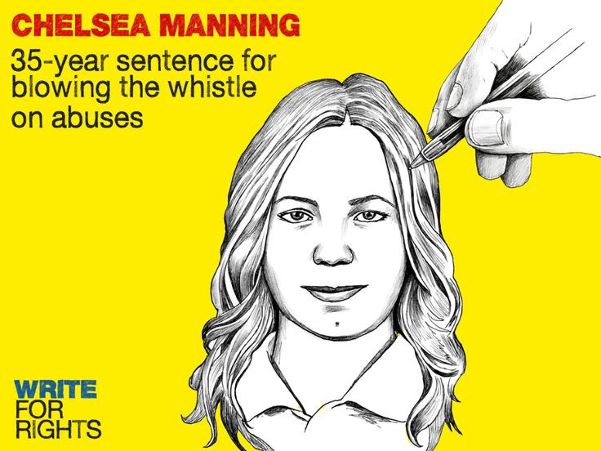

2014
WRITE FOR RIGHTS CASE:
Chelsea Manning
“Your messages from beyond the prison walls have become an enormous source of strength for me. I would like to thank all of the members of Amnesty International and its supporters for all of the wonderful work they are doing on [my] behalf.”
RELEASED

Slide 9
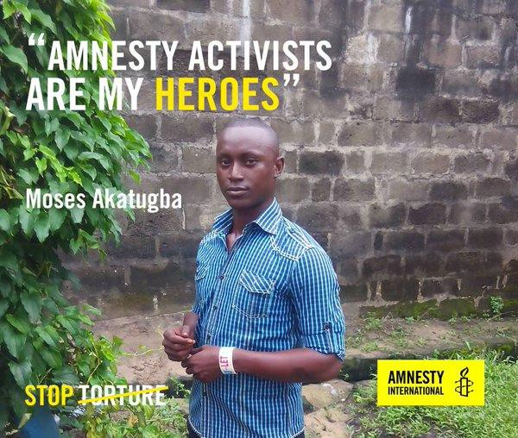


2014
WRITE FOR RIGHTS CASE:
MOSES
AKATUGBA
When he was only 16 years old, in 2005, Moses Akatugba was arrested, tortured, and eventually sentenced to death for a robbery he says he did not commit. In 2014, he was one of the Write for Rights cases. Now, he is free.

Slide 10
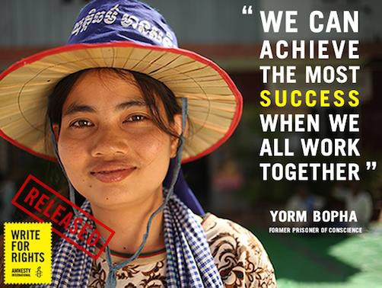


2013
WRITE FOR RIGHTS CASE:
YORM
BOPHA
Jailed in Cambodia after protesting against forced evictions in her community, Yorm Bopha was released in November 2013 after authorities received nearly 253,000 letters from Amnesty supporters during Write for Rights 2013.

Slide 11
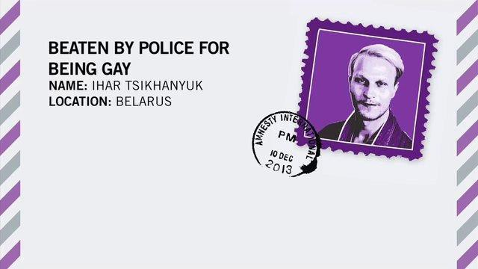
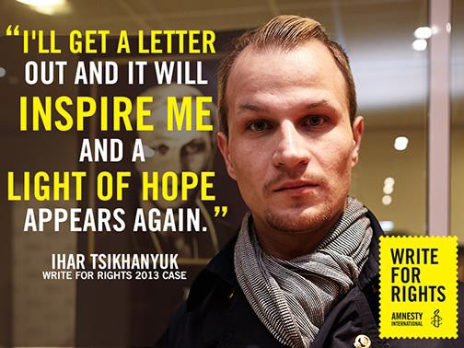


2013 WRITE FOR RIGHTS CASE:
IHAR TSIKHANYUK
After Write for Rights 2013, Ihar was released without charge and created a support group for families of gay children.

Slide 12


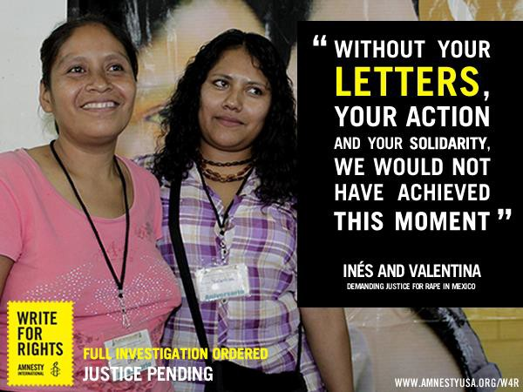
2011 WRITE FOR RIGHTS CASE:
INÉS AND VALENTINA
On February 16,
2002 Ines and Valentina, from the Me’phaa nation, were raped and beaten by officers in the Mexican army.
After Write for Rights 2011, the Mexican government finally accepted formal responsibility for the rape and abuse of Valentina and Inés by Mexican soldiers.

Slide 13
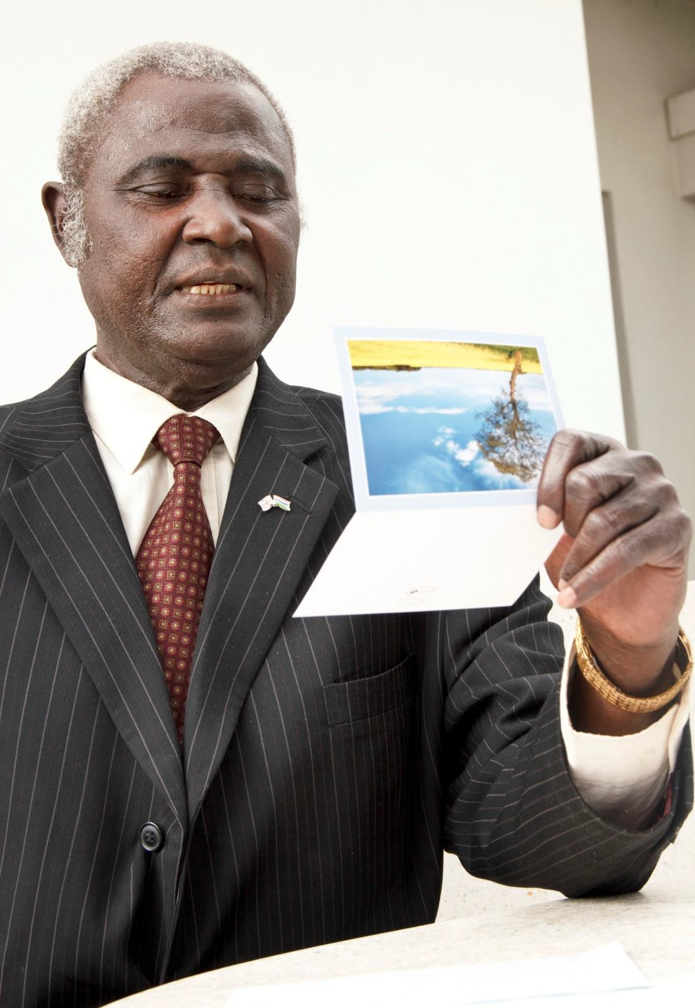


“I wanted a laptop for Christmas, but I got my father back, the biggest Christmas present ever.”
Femi Peters Jr., son of Femi Peters (pictured right), was arrested during a peaceful political demonstration in Gambia in 2009. He was a feature case in Write for Rights 2010 and was released in Gambia on Human Rights Day.
2010 WRITE FOR RIGHTS CASE:
FEMI PETERS

Slide 14


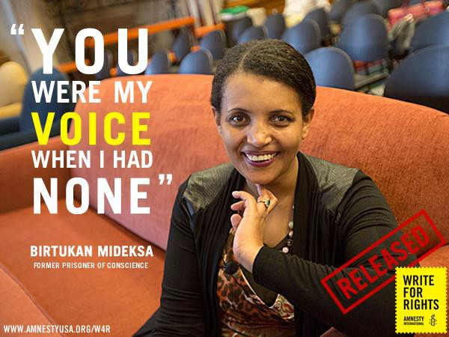
Birtukan Mideksa was imprisoned for exercising her right to freedom of expression. She was featured in Amnesty’s Write for Rights 2009. The government in Ethiopia released her after she served 21 months of a life sentence.
2009
WRITE FOR RIGHTS CASE:
BIRTUKAN
MIDESKA

Slide 15
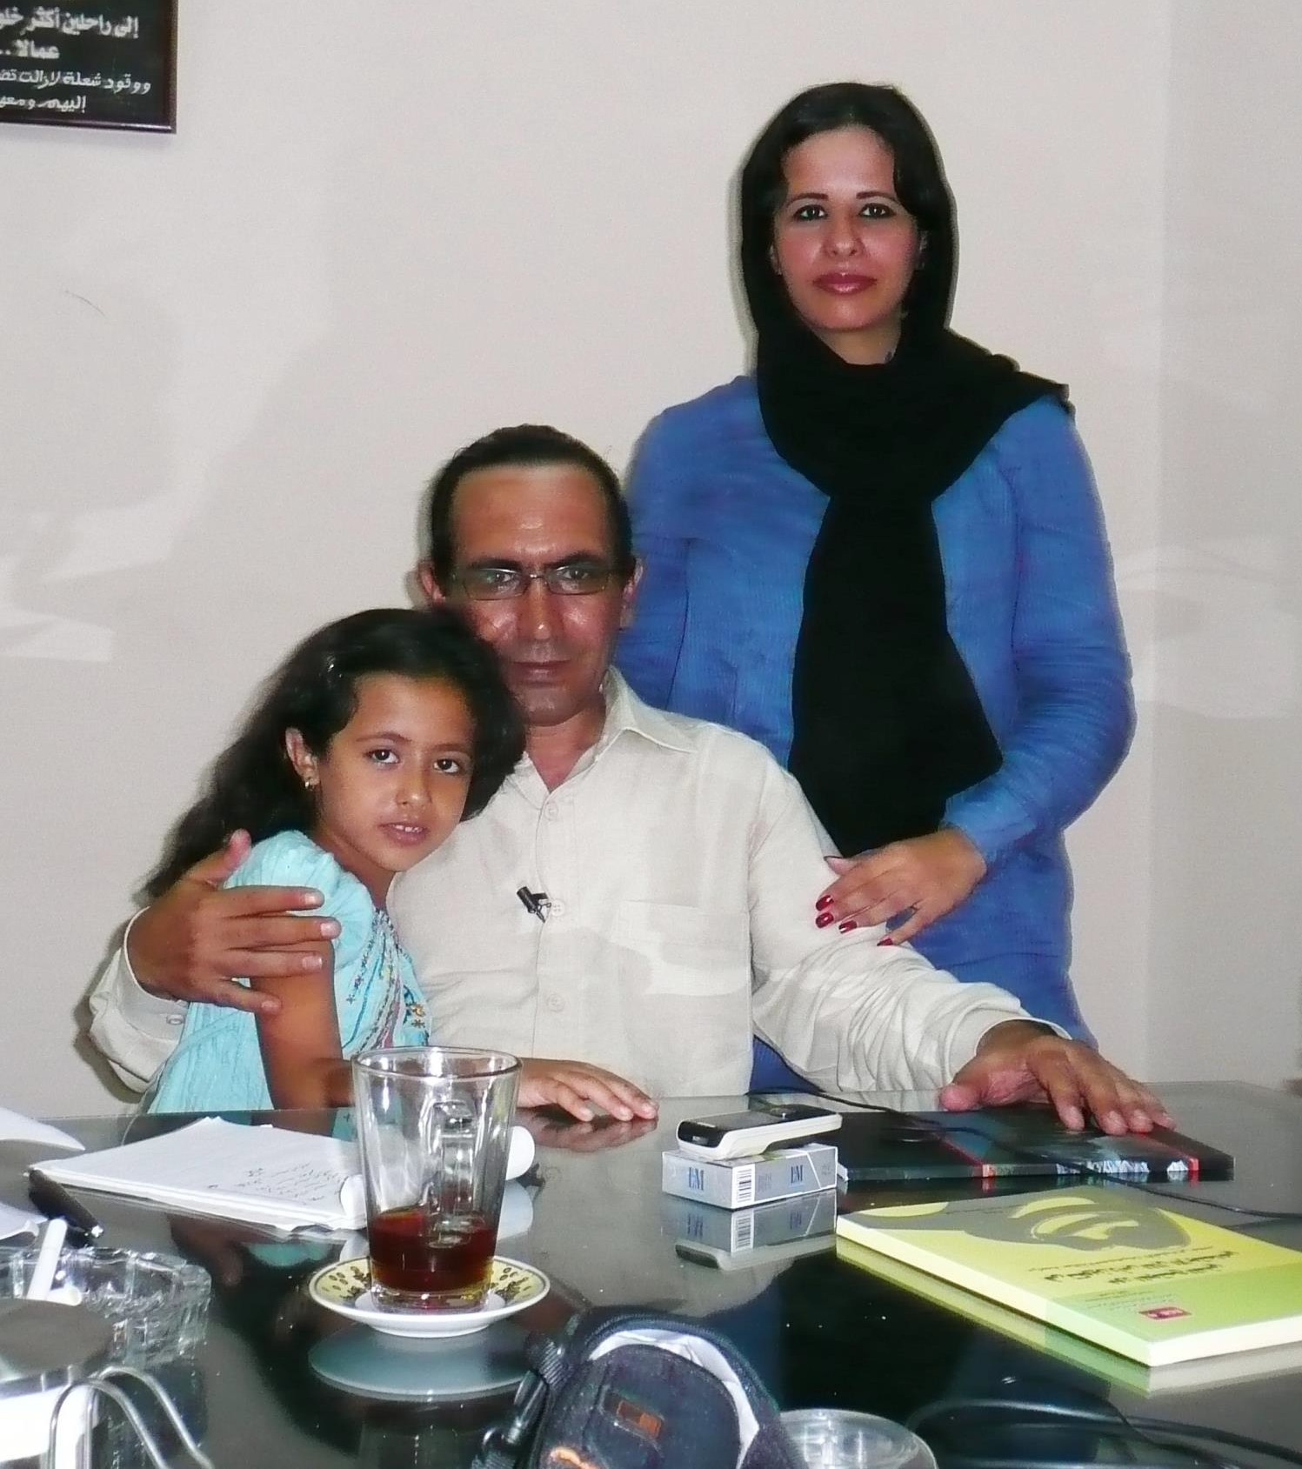


“Amnesty International's support is one of the reasons that I was released. Your messages gave me a sense of solidarity.”
Musaad Abu Fagr was a Write for Rights 2009 case. In July 2010, the authorities in Egypt released this Bedouin writer and activist from detention.
2009 WRITE FOR RIGHTS CASE:
MUSAAD ABU FAGR

Slide 16

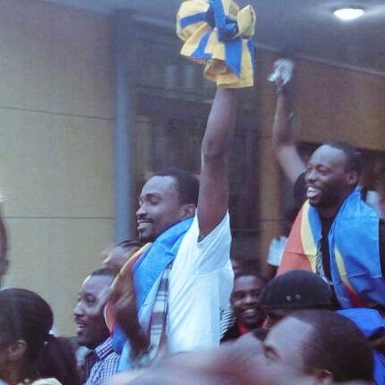

“Every letter, every visit, every word has strengthened us and reinforced our determination in this long but just struggle for freedom and democracy,” said Yves. Ten of their fellow activists, all members of the LUCHA youth movement, were also released in 2016.
2005 WRITE FOR RIGHTS CASE:
Fred Bauma & Yves Makwamba

Slide 17
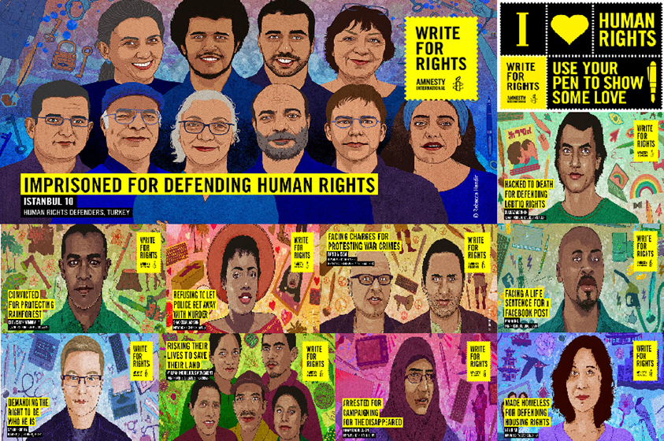

WRITE 4 RIGHTS 2017
DECEMBER 10
©Rebecca Hendin
WRITE LIKE SOMEONE’S LIFE
DEPENDS ON IT.
WWW.WRITEATHON.CA

